Slide 1

Establishing a Just, Learning Culture Shane Tinsley July 13, 2024 CSD 380: DevOps 9.2 Dr. Joseph Issa
CSD 380: DevOps 9.2 Dr. Joseph Issa

Slide 2

What is a Just Culture?
Definition: A just culture balances accountability with a focus on learning and improvement.
Importance: It encourages transparency, reduces fear of punishment, and promotes continuous learning.

Slide 3
The Learning Curve Concept
Definition: A learning curve represents the rate of improvement in performing a task over time.
Application: In a just culture, the learning curve reflects the time and effort required to shift organizational mindset and behaviors.

Slide 4
Phases of the Learning Curve (Page, 2007):
Initial Awareness:
Description: Introduction to just culture principles.
Activities: Training sessions, workshops, and communication from leadership.
Adoption:
Description: Early adoption of practices.
Activities: Pilot programs, feedback loops, and initial implementation of just culture policies.
Integration:
Description: Widespread adoption and integration into daily practices.
Activities: Continuous reinforcement, advanced training, and policy adjustments.
Sustained Improvement:
Description: Just culture becomes ingrained in the organizational culture.
Activities: Ongoing evaluation, continuous learning initiatives, and performance monitoring.

Slide 5

Time and Effort Required (Paige, 2007):
Initial Awareness: 3-6 months
Adoption: 6-12 months
Integration: 12-24 months
Sustained Improvement: 24+ months
Total Time: Approximately 2-3 years for full implementation

Slide 6

Key Challenges (Gain, 2004):
Resistance to Change:
Solution: Strong leadership support and clear communication.
Resource Allocation:
Solution: Dedicated budget and personnel for training and development.
Cultural Shift:
Solution: Consistent reinforcement of just culture principles and values.

Slide 7

Best Practices for Implementation (Page, 2007):
Leadership Commitment:
Visible support from top management.
Comprehensive Training:
Ongoing education and skill development.
Open Communication:
Encourage reporting and discussions without fear of retribution.
Continuous Evaluation:
Regular assessments and adjustments based on feedback and performance data.

Slide 8
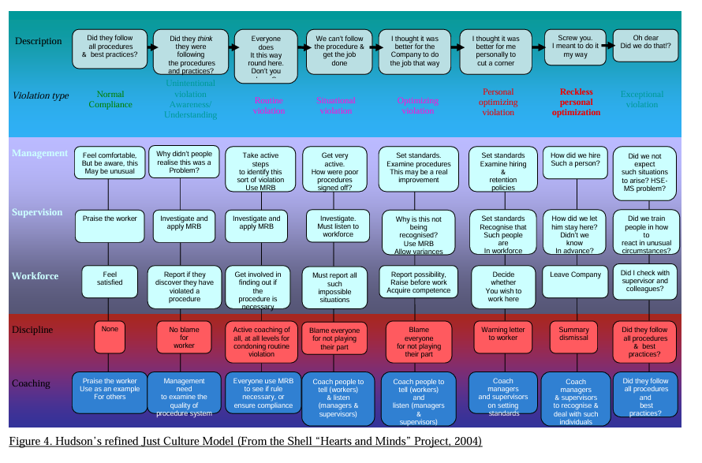
Hudson’s refined Just Culture Model (Gain, 2004):
Hudson's model operationalizes the Just Culture principles by providing clear guidance on actions to take for different types of violations, ensuring that responses are consistent, fair, and aimed at improving overall safety and performance.

Slide 9

Summing UP
Just Culture is essential for creating a safe, transparent, and accountable organizational environment. The learning curve reflects the organization's journey from initial awareness to fully embedding Just Culture principles, ultimately leading to enhanced safety, performance, and employee morale (Hudson, 2004).

Slide 10
References
Gain. (2004). Roadmap to a Just Culture. FlightSafety. https://flightsafety.org/files/just_culture.pdf
Hudson, P. T. W. (2004). The Hearts and Minds Project. ResearchGate. https://www.researchgate.net/publication/281236607_The_Hearts_and_Minds_Project
Page, A. H. (2007). Making Just Culture a Reality: One Organization’s Approach. PSNet. https://psnet.ahrq.gov/perspective/making-just-culture-reality-one-organizations-approach#:~:text=Establishing%20a%20just%20culture%20within,and%20processes%20of%20daily%20work.

